Slide 1
AMERICA’S BEGINNINGS
THE DECLARATION OF INDEPENDENCE

Slide 2
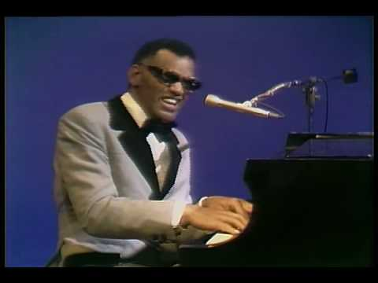
AMERICA THE BEAUTIFUL BY RAY CHARLES (1972)
1:38-3:10

Slide 3
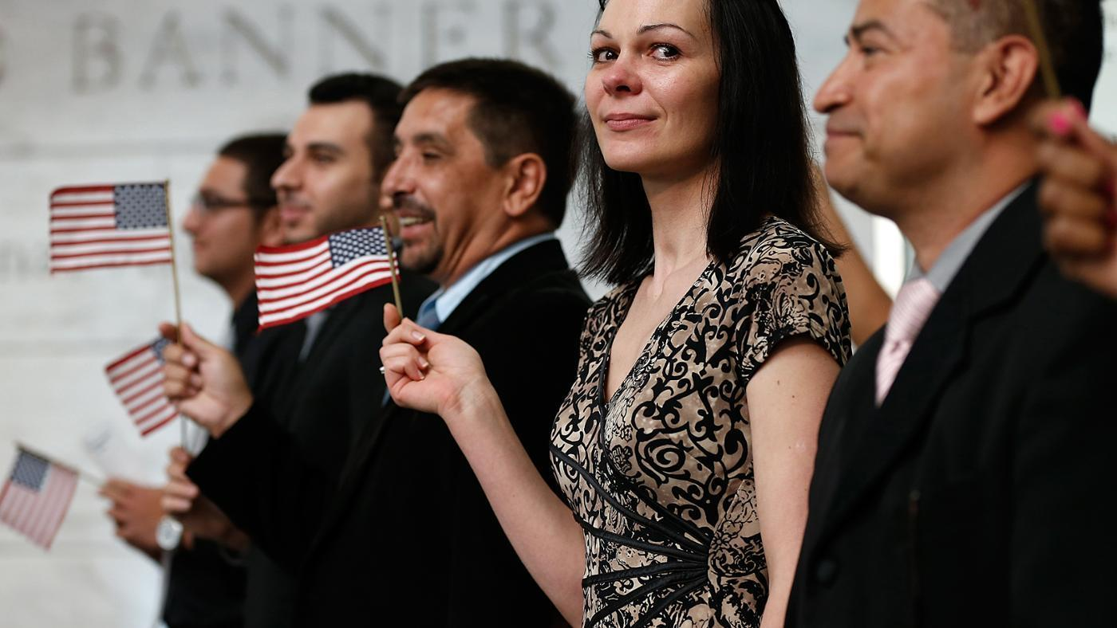
POLITICAL EQUALITY
To be free… WE MUST BE EQUAL
  To honor AND fight for each citizen’s freedom(s), we must share a bond with each other
Engage ALL members of a town, state, country
  How can I help my _______?
To avoid domination by others?
  Help build the structures of the world around us
The DECLARATION OF INDEPENDENCE will build that foundation from which our political world was born

Slide 4
THE WRITERS

Slide 5
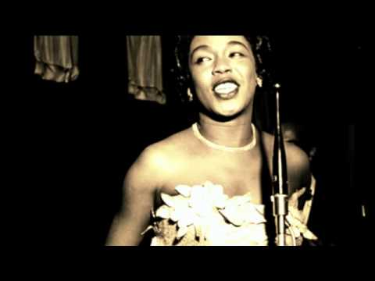
WHAT CAN THE WRITERS TEACH US?
RESILIENCY
Once I laughed when I heard you saying
that I'd be playing solitaire,
uneasy in my easy chair.
It never entered my mind.
Once you told me I was mistaken,
that I'd awaken with the sun
and order orange juice for one.
It never entered my mind.
1:10-2:10

Slide 6

HOW WOULD YOU KNOW THIS SONG ???
:35-1:10

Slide 7
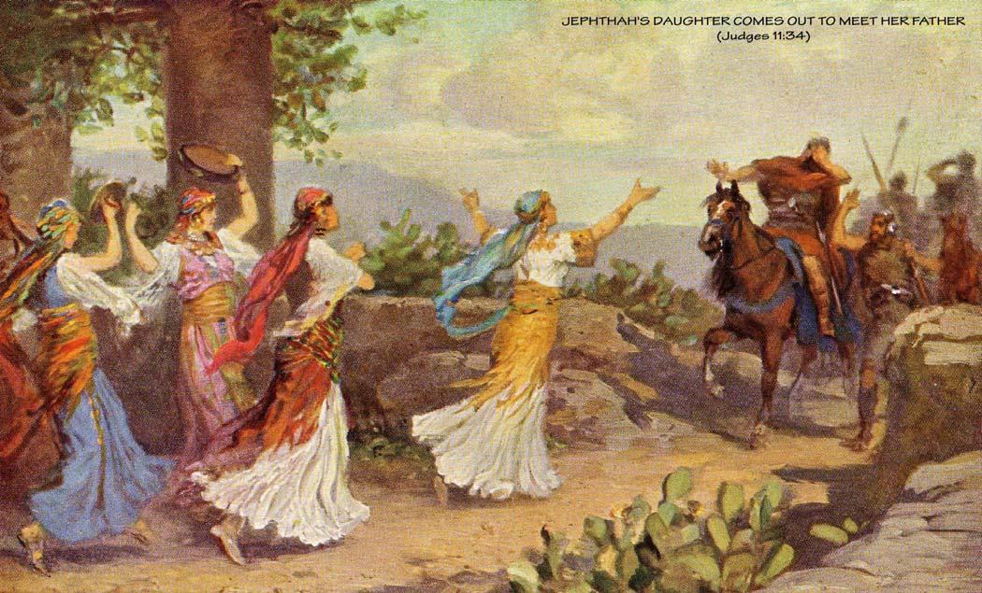
WHAT CAN THE WRITERS TEACH US?
SACRIFICE
JEPHTHAH
FAMOUS WARRIOR (in the Bible)
  IF GOD GRANTED HIM VICTORY IN BATTLE, HE WOULD SACRIFICE THE FIRST THING HE SAW WHEN HE CAME HOME
  HIS SACRIFICE???

Slide 8
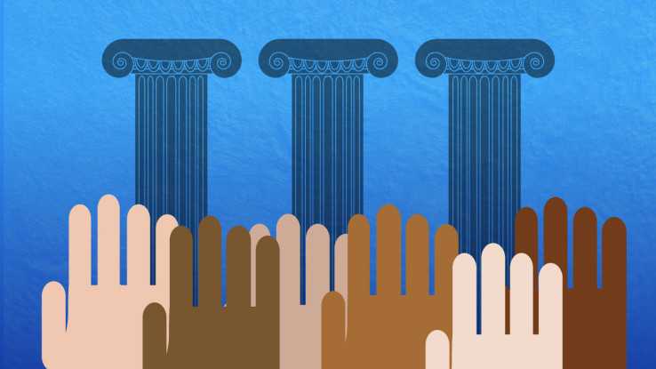
WORKING TOGETHER
Democratic Writing is a group effort
  Individuals must learn how to “weave” the words which form that way of life
How much that you have accomplished has been “individual”??

Slide 9
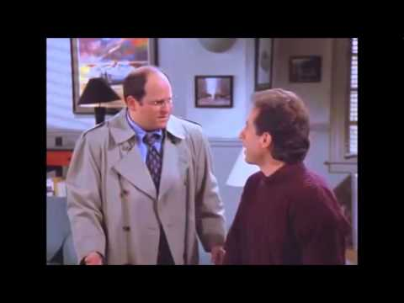
SEINFELD (“JERK STORE”)
1:00-2:19

Slide 10
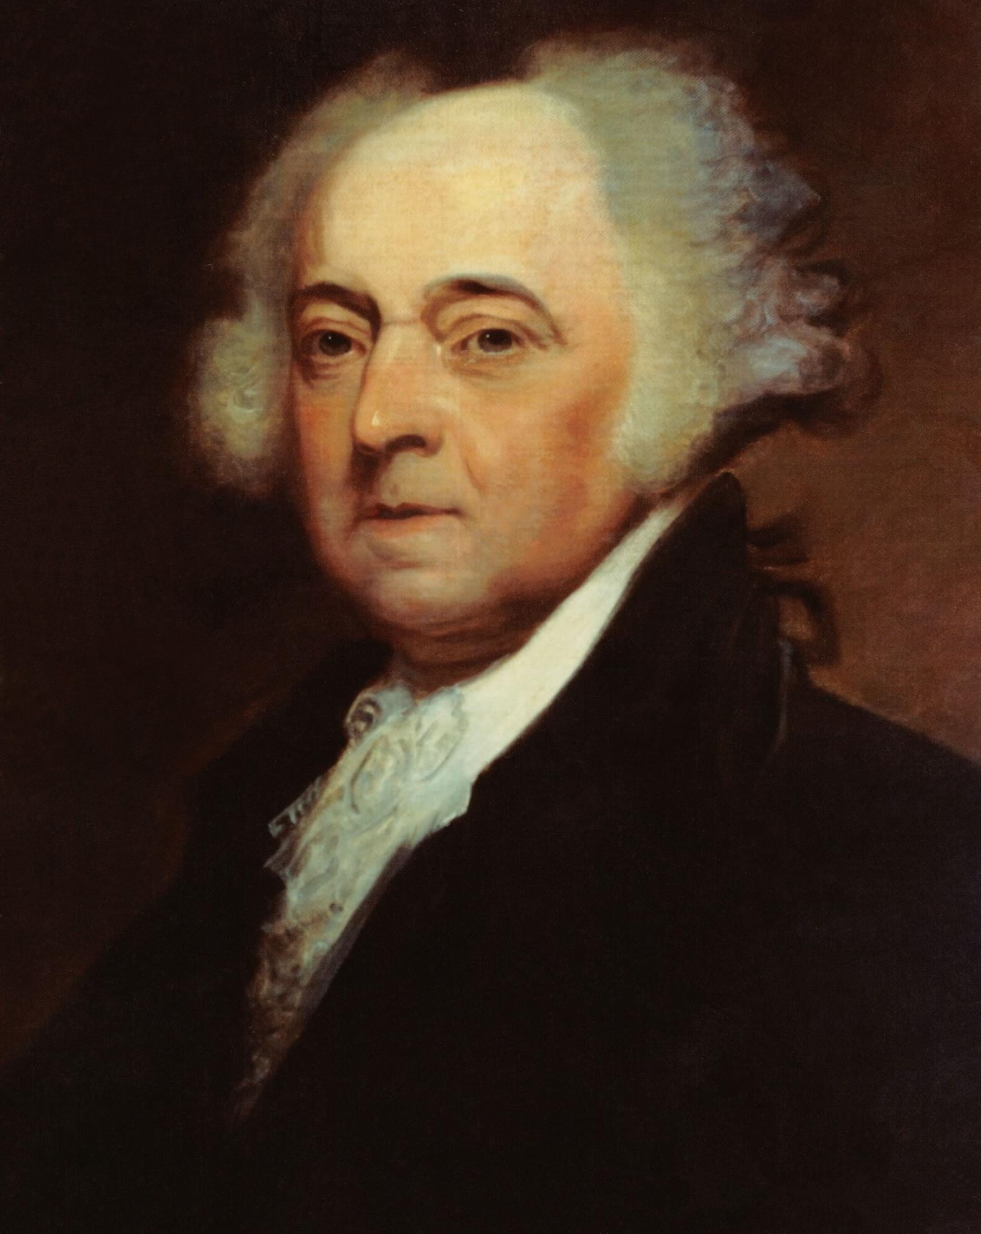
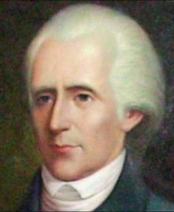
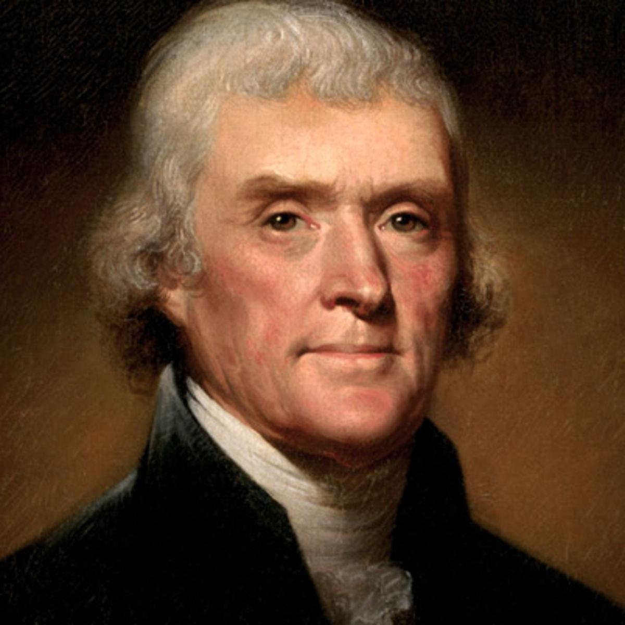
THE THREE RADICALS
JOHN ADAMS
RICHARD LEE
THOMAS JEFFERSON

Slide 11
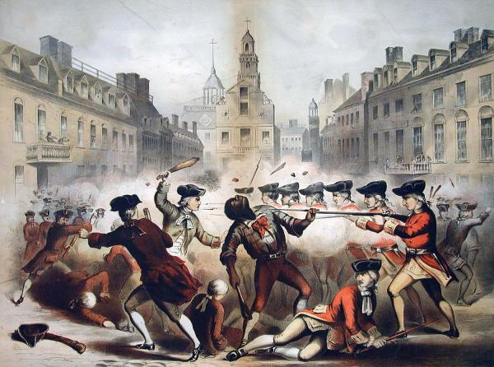
AN UNLIKELY MATCH

Slide 12
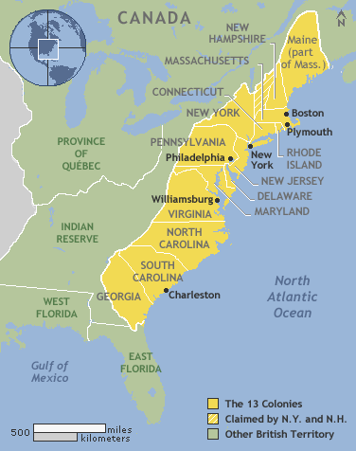
JUNE 1775
FIRST CONTINENTAL CONGRESS
Representatives from all 13 colonies gather in Philadelphia (PA)
TOPICS?
  Discuss issues involving unfair treatment by England
  Methods of notifying King George III of colonial unrest

Slide 13
JOHN ADAMS (2008)
https://www.youtube.com/watch?v=GckRP2xRKNw
0-1:20

Slide 14
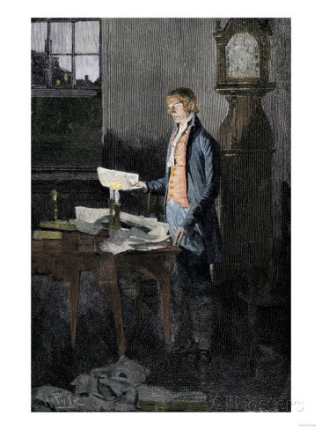
JEFFERSON’S SKILLS ARE DESIRED
A MASTER OF THE WRITTEN WORD
  JULY 1774: SUMMARY VIEW OF THE RIGHTS OF BRITISH AMERICA
HIS MESSAGE?
  INDEPENDENCE NOT RECONCILIATION!!!
ASKED TO WRITE “DECLARATION OF THE CAUSES AND NECESSITY OF TAKING UP ARMS “
  A LETTER TO KING GEORGE III TO EXPLAIN:
    WHY THE COLONIES WERE FORMING MILITIAS
    NEW TERMS OF GOVERNANCE

Slide 15
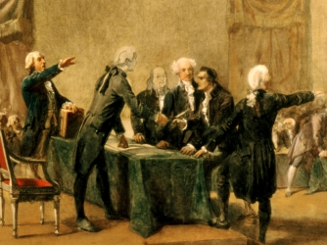
WHAT IS GOING ON?
MONTHS PASS WITH NO RESPONSE!!!
  WHAT DO YOU THINK KGIII’S RESPONSE WAS??
FALL 1775: COLONIAL COASTAL TOWNS ATTACKED BY BRITISH NAVY
  NEW HAMPSHIRE REQUESTS FCC HELP THEM FORM A STATE GOVNT.

Slide 16
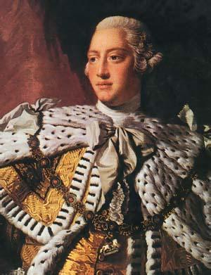
KING GEORGE III RESPONDS
KING GEORGE III NEVER READS THE ENTIRE DOCUMENT
  THE COLONIES WANT TO REBEL?… “SEND THE NAVY!!”
  HOW WOULD YOU HAVE REACTED TO THIS LETTER?

Slide 17
KING GEORGE III RESPONDS
OCT.26,1775: KING GEORGE III INFORMS PARLIAMENT HE WILL SEEK FOREIGN AID TO END THIS REBELLION
  NO TRADE WITH COLONIES
  VA’S ROYAL GOVERNOR DECLARES MARTIAL LAW
  ALL SLAVES AND SERVANTS WHO JOIN BRITISH ARMY WILL BE SET FREE

Slide 18
JOHN ADAMS (2008)
https://www.youtube.com/watch?v=5JTxVHQAp8w
0-2:01

Slide 19
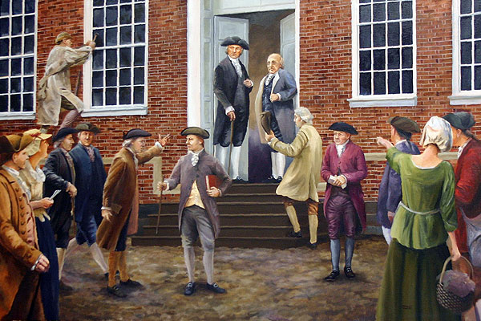
WE ARE JUSTIFIED
HOW DO WE BREAK FREE FROM ENGLAND?
  INDEPENDENCE HAS BEEN FORCED UPON US
  COLONIES NO LONGER PROTECTED BY ENGLAND
  WE HAVE NO GOVNTS.!!
ALL 13 COLONIES BEGIN PLANS FOR THEIR OWN GOVERNMENTS!

Slide 20
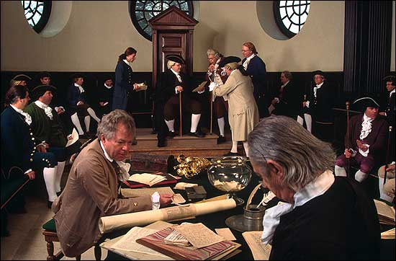
EARLY 1776
NEW HAMPSHIRE ESTABLISHES OWN CONSTITUTION
  NC, NJ, VA REQUEST ADAMS’S HELP TO WRITE THEIRS AS WELL
JOHN ADAMS WRITES “THOUGHTS ON GOVERNMENT”
  “HAPPINESS OF SOCIETY IS THE END OF GOVERNMENT”
RICHARD LEE CIRCULATES A REVOLUTIONARY POSTER
  MAY 1776: LEE HAS TWO GOALS FOR THE VA COLONIAL CONVENTION
    SET UP A CONSTITUTION
    WRITE A PROPOSAL FOR INDEPENDENCE OF ALL COLONIES

Slide 21
MAY-JULY 1776
SECOND CONTINENTAL CONGRESS
MAY 10: ADAMS (SUPPORTED BY LEE) PROPOSED TO CONGRESS THAT ALL COLONIES SHOULD ADOPT NEW GOVERNMENTS
MAY 15: ALL COLONIES AGREE, FORM “STATE” CONSTITUTIONS
TIME TO START WRITING A “DECLARATION… OF INDEPENDENCE”

Slide 22
THE ROAD TO THE DECLARATION

Slide 23
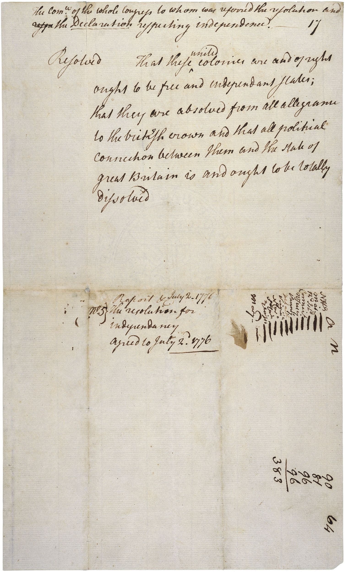
MAY-JULY 1776
JUNE 7,1776: RICHARD LEE STANDS BEFORE THE SECOND CONTINENTAL CONGRESS AND PUTS FORTH A MOTION FOR INDEPENDENCE…
“ RESOLVED, THAT THESE UNITED COLONIES ARE, AND OF RIGHT OUGHT TO BE, FREE AND INDEPENDENT STATES, THAT THEY ARE ABSOLVED FROM ALL ALLEGIANCE TO THE BRITISH CROWN, AND THAT ALL POLITICAL CONNECTION BETWEEN THEM AND THE STATE OF GREAT BRITAIN IS, AND OUGHT TO BE, TOTALLY DISSOLVED…”

Slide 24
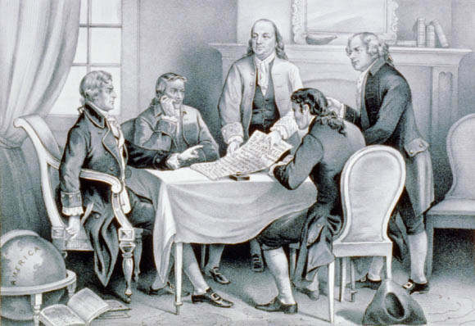
MAY-JULY 1776
EACH STATE HAD TWO MONTHS TO CONFER BEFORE VOTING IN JULY
  ADAMS WANTED UNANIMOUS SUPPORT… WHY?
JUNE 11, 1776:
  THE COMMITTEE OF FIVE
    JOB? DRAFT A DECLARATION OF INDEPENDENCE
      BEN FRANKLIN (PA)
      JOHN ADAMS (MA)
      THOMAS JEFFERSON (VA)**
      ROGER SHERMAN (CT)
      ROBERT LIVINGSTON (NY)

Slide 25
JOHN ADAMS TO THOMAS JEFFERSON...
“ REASON 1ST. YOU ARE A VIRGINIAN AND A VIRGINIAN OUGHT TO APPEAR AT THE HEAD OF THIS BUSINESS. REASON 2ND. I AM OBNOXIOUS, SUSPECTED, AND UNPOPULAR, YOU ARE VERY MUCH OTHERWISE. REASON 3RD. YOU CAN WRITE TEN TIMES BETTER THAN I CAN.”

Slide 26
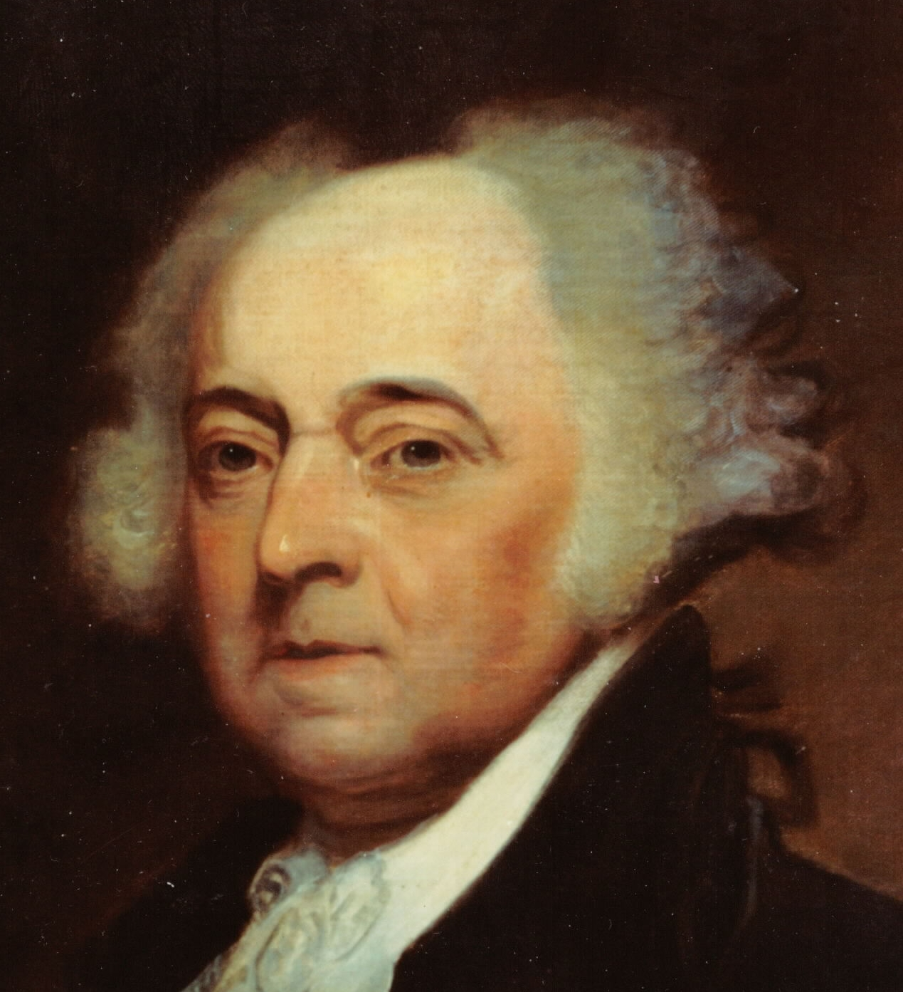
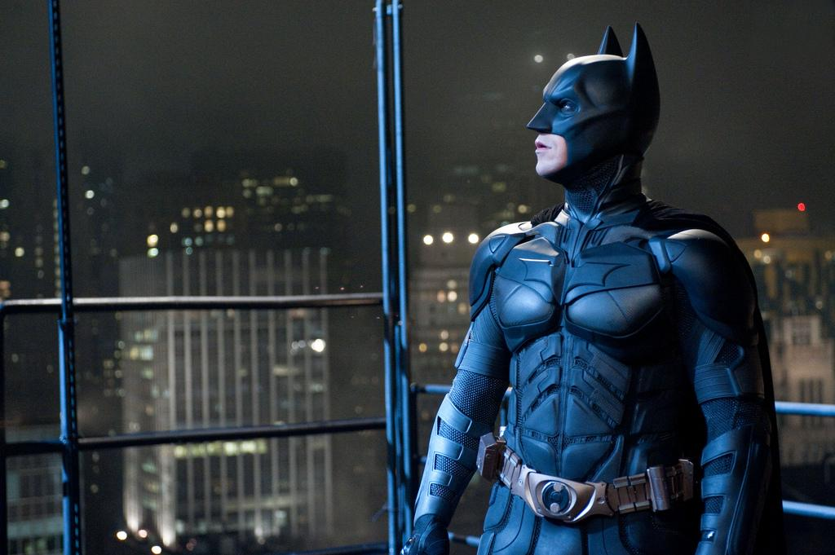
JOHN ADAMS IS AMERICA’S DARK KNIGHT

Slide 27
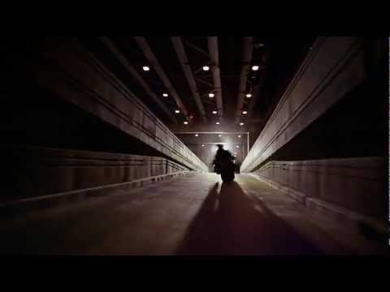
THE DARK KNIGHT (2008)

Slide 28
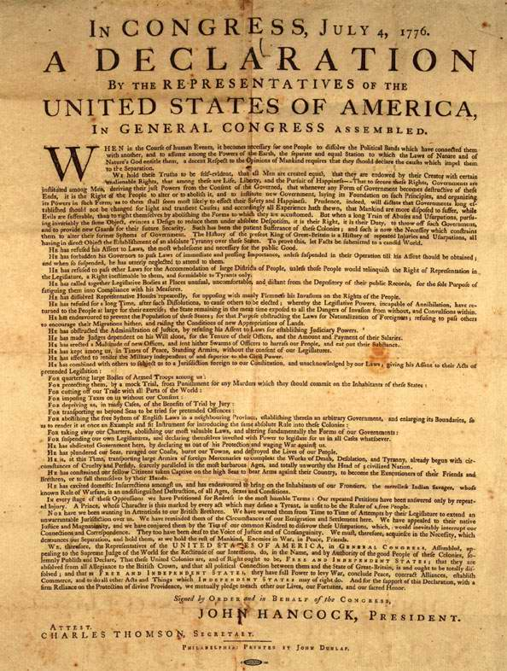
IT’S READY!
JUNE 28,1776:
  THE COMMITTEE OF FIVE PRESENTED A FINISHED DRAFT TO THE SCC
“WHERE DID JEFFERSON GET ALL OF HIS IDEAS FROM???”
  AT THE SAME TIME… JEFFERSON IS WRITING THE VA STATE CONSTITUTION
  JEFFERSON BORROWS HEAVILY FROM TWO MEN… GEORGE MASON & JOHN ADAMS

Slide 29
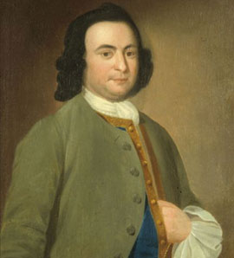
A BILL OF RIGHTS
GEORGE MASON DRAFTS VIRGINIA’S BILL OF RIGHTS
INCLUDES THOUGHTS ON:
  WHERE MAN’S RIGHTS COME FROM
  WHICH RIGHTS ARE EVERY MAN ENTITLED TO
  WHERE DOES POWER ORIGINATE IN GOVERNMENT
  WHEN SHOULD PEOPLE REBEL AGAINST THE GOVERNMENT
**GROUP ACTIVITY: COMPARE DOCUMENTS**

Slide 30
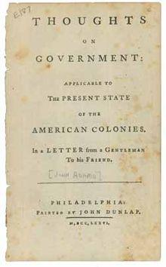
JOHN ADAMS… THE INFLUENTIAL
THOUGHTS ON GOVERNMENT
APRIL 1776
REASONS WHY EACH COLONY SHOULD BREAK FREE OF ENGLAND’S CONTROL
HOW TO SET UP THEIR OWN GOVERNMENTS
** WATCH “JOHN ADAMS” PART 3… 30:05 - 34:44 **
**REVIEW DOCUMENT WITH CLASS**

Slide 31
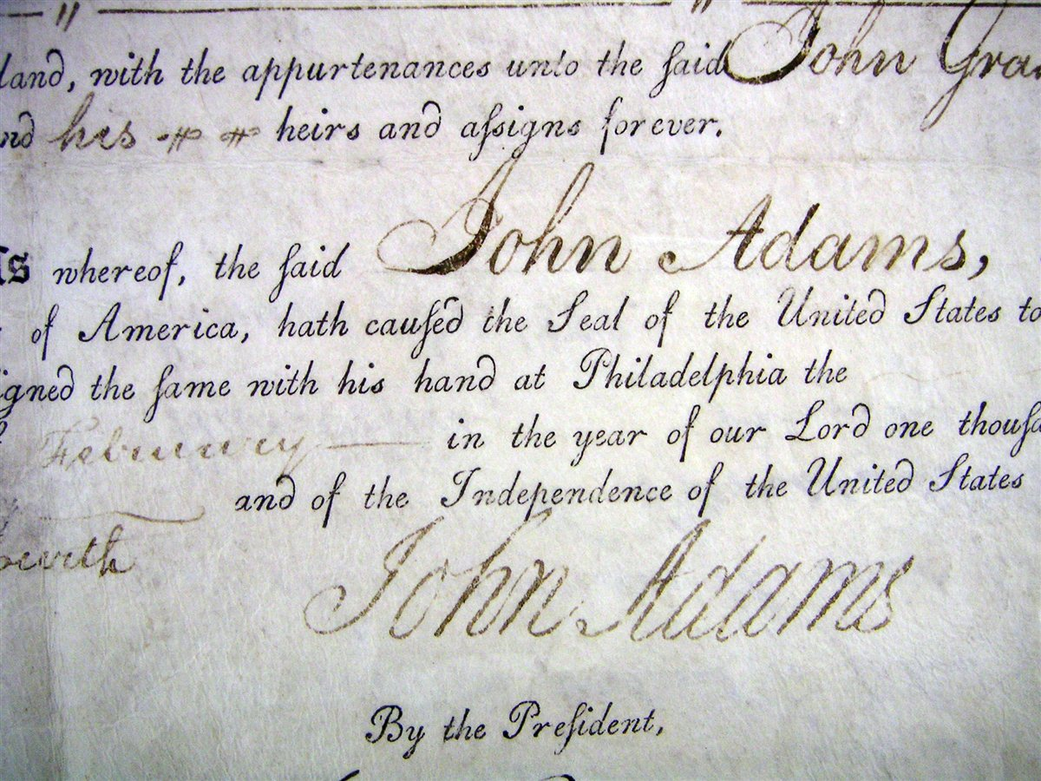
ONE FINAL PLEA
BEFORE THE FINAL VOTE, JOHN ADAMS PLEADS THE CAUSE OF INDEPENDENCE…ONE LAST TIME
https://www.youtube.com/watch?v=cUeOCjcgVsE
0-2:37

Slide 32
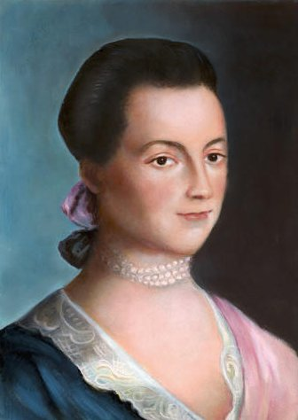
THE “REAL” INFLUENCE ??
ABIGAIL ADAMS
HOMESCHOOLED
VORACIOUS READER
JOHN DESCRIBED ABIGAIL AS HIS “BALLAST”
  JOHN: BRASH, ARGUMENTATIVE
  ABIGAIL: INTELLIGENT, ARTICULATE, GRACEFUL
JOHN’S #1 SOUNDING BOARD FOR MANY OF HIS THOUGHTS, LETTERS, SPEECHES
http://www.c-span.org/video/?c4285367/david-mccullough-describes-abigail-adams
https://www.youtube.com/watch?v=WXQZIo6JN2Q

Slide 33
SEPTEMBER 30, 1764 (JOHN TO ABIGAIL; 1 MONTH FROM WEDDING DAY )
Oh my dear Girl, I thank Heaven that another Fortnight will restore you to me -- after so long a separation. My soul and Body have both been thrown into Disorder, by your Absence, and a Month of two more would make me the most insufferable Cynick, in the World. I see nothing but Faults, Follies, Frailties and Defects in any Body, lately. People have lost all their good Properties or I my justice, or Discernment.
But you who have always softened and warmed my Heart, shall restore my Benevolence as well as my Health and Tranquility of mind. You shall polish and refine my sentiments of Life and Manners, banish all the unsocial and ill natured Particles in my Composition, and form me to that happy Temper, that can reconcile a quick Discernment with a perfect Candour.

Slide 34
SEPTEMBER 14, 1767 (ABIGAIL TO JOHN)
The Doctor talks of Setting out tomorrow for New Braintree. I did not know but that he might chance to see you, in his way there. I know from the tender affection you bear me, and our little one's that you will rejoice to hear that we are well, our Son is much better than when you left home, and our Daughter rock's him to Sleep, with the Song of "Come pappa come home to Brother Johnny." Sunday seems a more Lonesome Day to me than any other when you are absent, For tho I may be compared to those climates which are deprived of the Sun half the Year, yet upon a Sunday you commonly afforded us your benign influence. I am now at Weymouth. My Father brought me here last night. To morrow I return home, where I hope soon to receive the Dearest of Friends and the tenderest of Husbands, with that unabated affection which has for Years past, and will whilst the vital Spark lasts, burn in the Bosom of your affectionate.

Slide 35
JUNE 26, 1776 (JOHN TO ABIGAIL)
The Congress have been pleased to give me more Business than I am qualified for, and more than I fear, I can go through, with safety to my Health. They have established a Board of War and Ordinance and made me President of it, an Honour to which I never aspired, a Trust to which I feel myself vastly unequal. But I am determined to do as well as I can and make Industry supply, in some degree the Place of Abilities and Experience. The Board sits, every Morning and every Evening. This, with Constant Attendance in Congress, will so entirely engross my Time, that I fear, I shall not be able to write you, so often as I have. But I will steal Time to write to you.

Slide 36
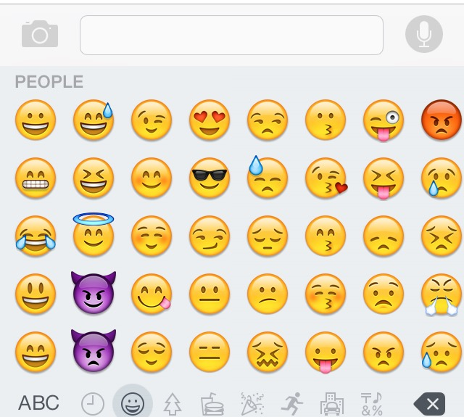
ACTIVITY
REWRITE JOHN ADAM’S 1764 LOVE LETTER USING ONLY EMOJIS
AT LEAST 6 SYMBOLS

Slide 37
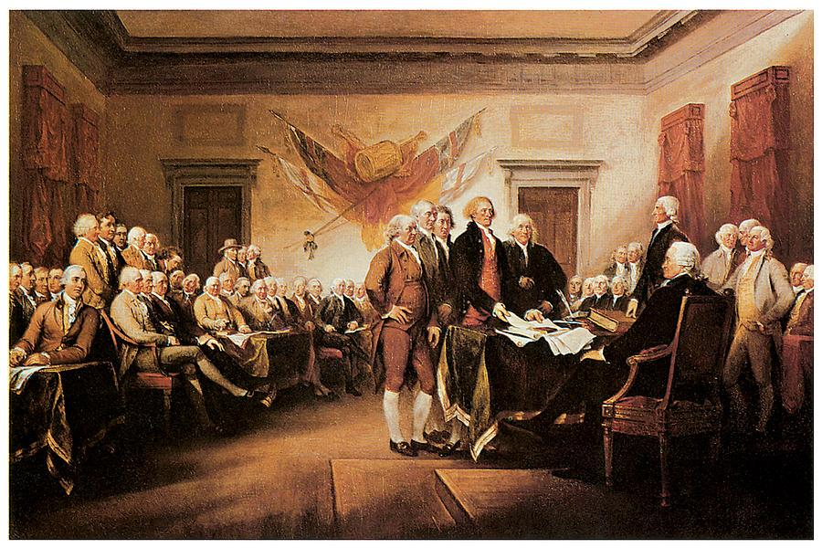
THE VOTE
JULY 2, 1776
THE VOTE FOR INDEPENDENCE OCCURS
FINAL TALLY:
  12 to O (NY ABSTAINS)
https://www.youtube.com/watch?v=nrvpZxMfKaU

Slide 38
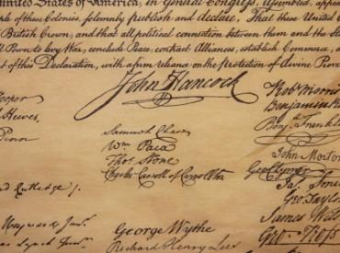
THE DATE YOU KNOW...
JULY 4, 1776
THE DECLARATION OF INDEPENDENCE WAS STILL BEING EDITED ON JULY 2
  JULY 4 WAS THE DATE THE TEXT WAS APPROVED
  OFFICIAL SIGNING: AUGUST 2, 1776

Slide 39
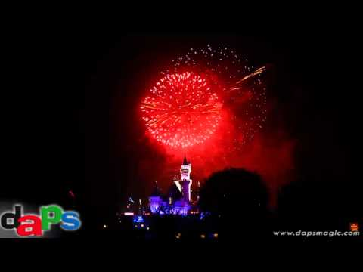
JOHN ADAMS’ VISION OF JULY 4TH
JULY 3, 1776 (JOHN TO ABIGAIL)
“I am apt to believe that it will be celebrated, by succeeding Generations, as the great anniversary Festival. It ought to be commemorated, as the Day of Deliverance by solemn Acts of Devotion to God Almighty. It ought to be solemnized with Pomp and Parade, with Shews, Games, Sports, Guns, Bells, Bonfires and Illuminations from one End of this Continent to the other from this Time forward forever more.”
2:00 - 3:05

Slide 40
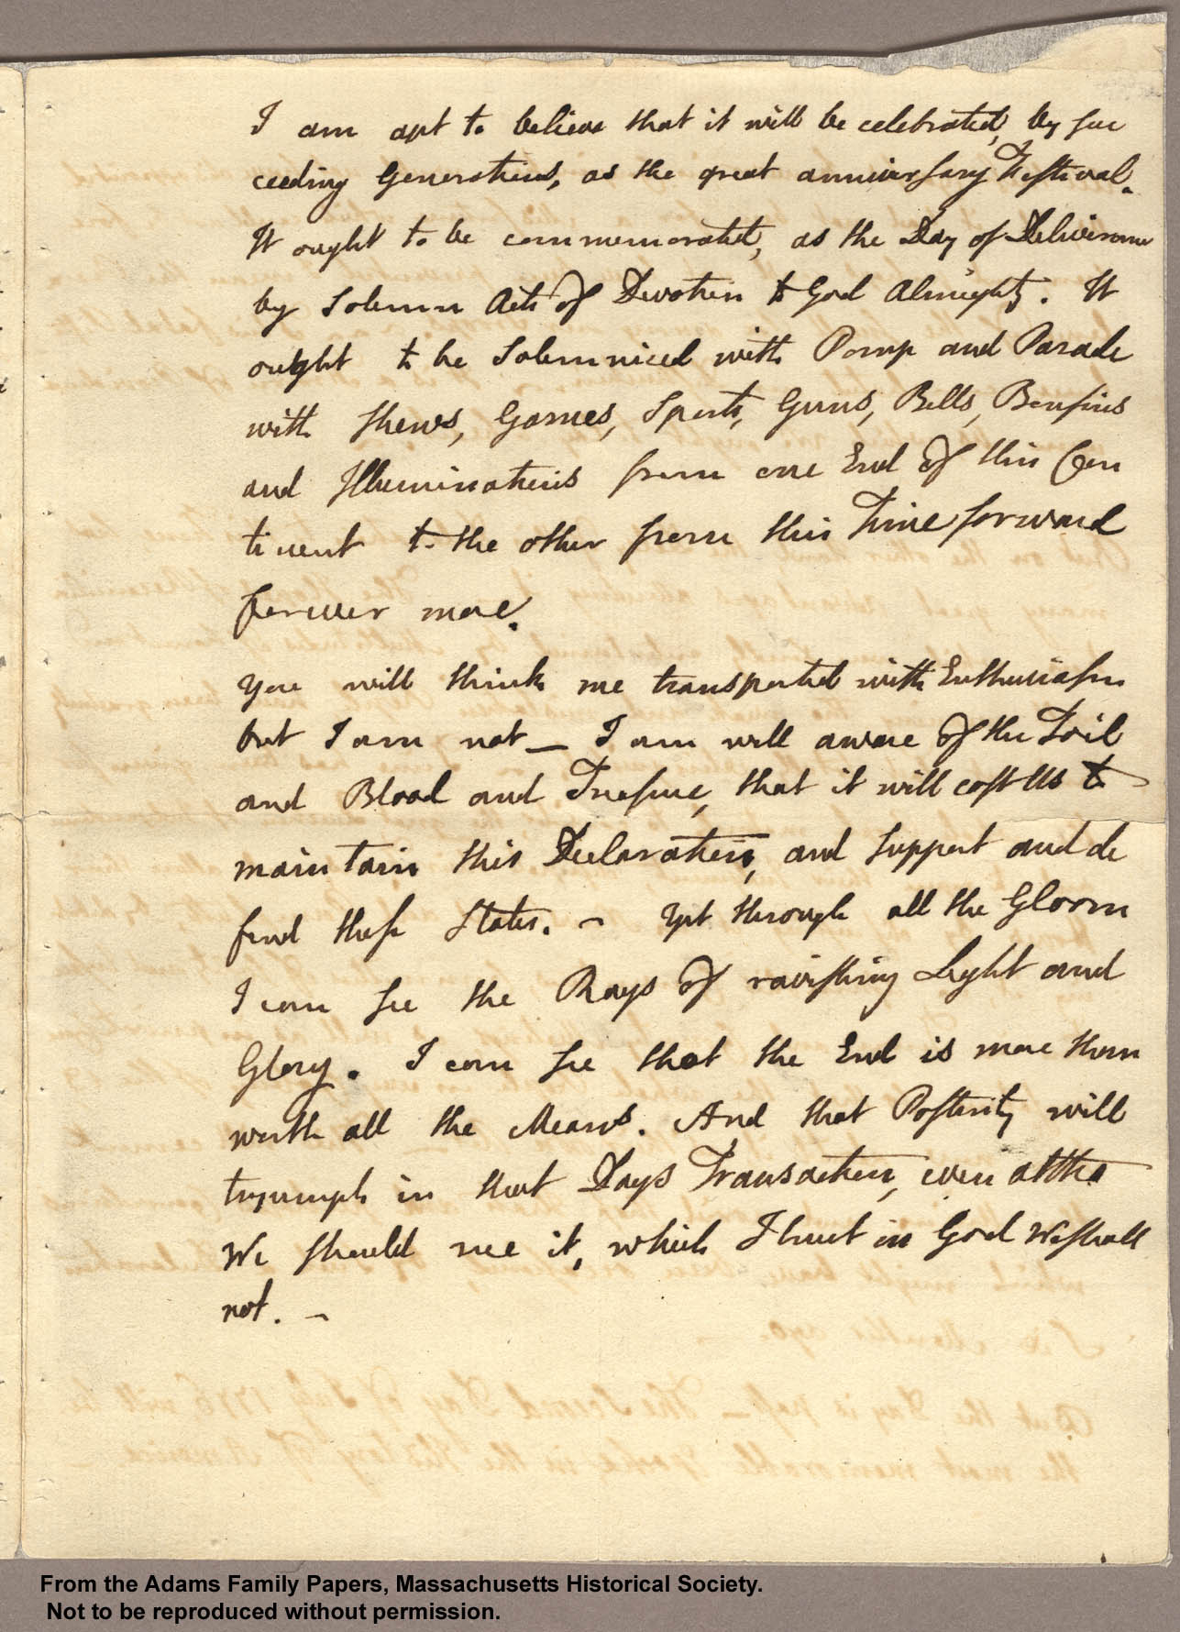
… BUT HE ALSO KNOWS THE TRUTH
“ You will think me transported with Enthusiasm but I am not. -- I am well aware of the Toil and Blood and Treasure, that it will cost Us to maintain this Declaration, and support and defend these States. -- Yet through all the Gloom I can see the Rays of ravishing Light and Glory. I can see that the End is more than worth all the Means. And that Posterity will tryumph in that Days Transaction, even altho We should rue it, which I trust in God We shall not.”

Slide 41
THE EDITORS

Slide 42
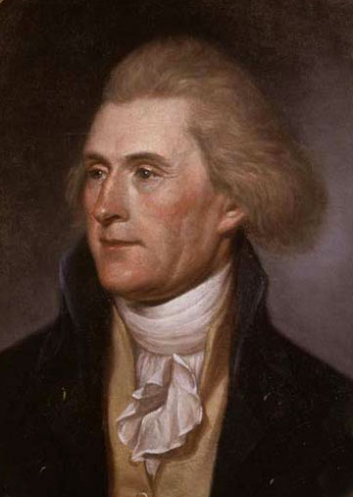
THE BIG QUESTION
WAS THOMAS JEFFERSON A CHEATER?

Slide 43
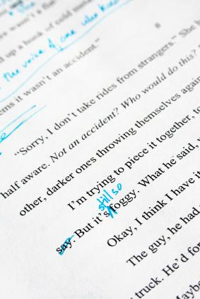
A FEW CHANGES
BETWEEN JULY 2 AND JULY 4…
CLOSE TO 25% OF JEFFERSON’S ORIGINAL DRAFT HAD BEEN REMOVED BY THE Cof5 and THE SCC

Slide 44
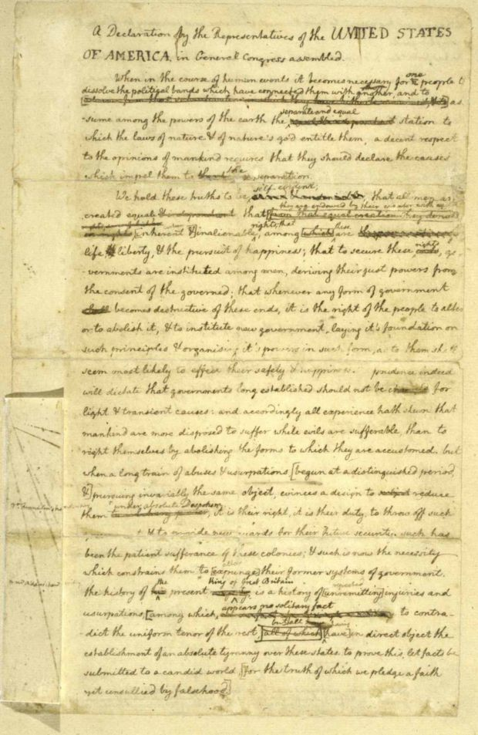

Slide 45
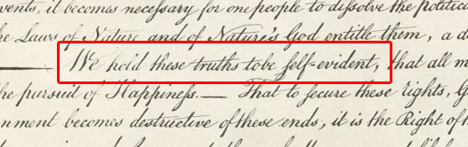
A BETTER START...
“WE HOLD THESE TRUTHS TO BE SACRED AND UNDENIABLE…”
“WE HOLD THESE TRUTHS TO BE SELF-EVIDENT…”

Slide 46
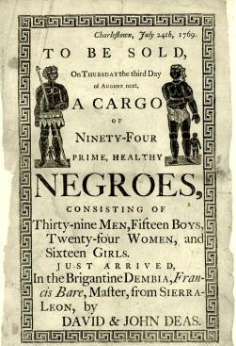
WHAT TO DO ABOUT SLAVERY?
JEFFERSON HAD A LARGE SECTION OF HIS ORIGINAL DRAFT DETAILING THE ILLS OF SLAVERY REMOVED
“HE (King George III) HAS WAGED CRUEL WAR AGAINST HUMAN NATURE ITSELF, VIOLATING IT’S MOST SACRED RIGHTS OF LIFE & LIBERTY IN THE PERSONS OF A DISTANT PEOPLE WHO NEVER OFFENDED HIM…”
https://www.youtube.com/watch?v=U0_3KzuYuh0

Slide 47
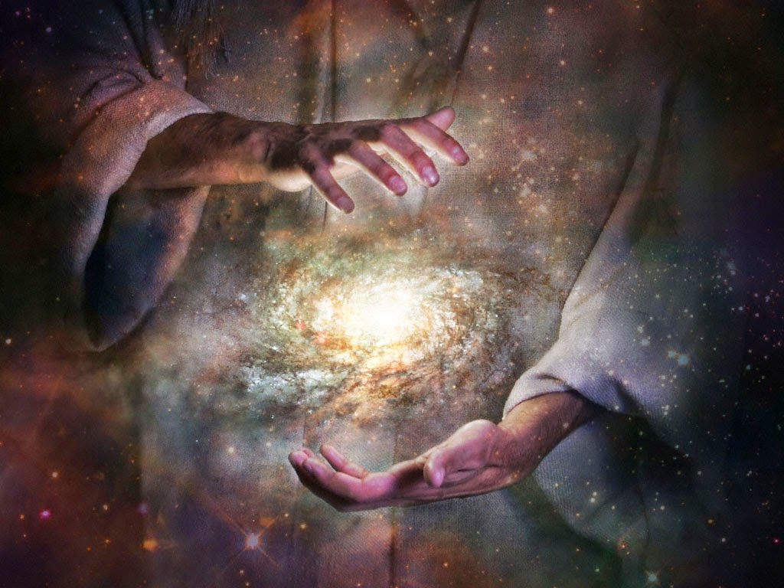
SEPARATION OF CHURCH & STATE
JEFFERSON’S ORIGINAL DRAFT BARELY MENTIONS GOD OR A GOD
JEFFERSON WANTED TO MAKE THE D of I AS PEOPLE-CENTRIC AND SECULAR AS POSSIBLE
THE Cof5 AND SCC WOULD ADD TERMS SUCH AS:
“SUPREME JUDGE OF THE WORLD”
“CREATOR”
“DIVINE PROVIDENCE”

Slide 48
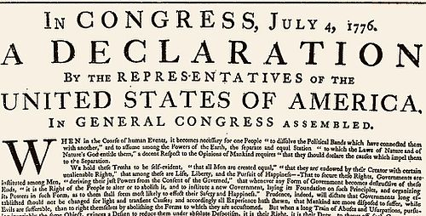
SOME SELECTED PRINTERS
JOHN DUNLAP
  COPIED D of I INTO A POSTER FOR NEWSPAPERS TO PRINT
CHARLES THOMSON
  MADE A COPY FOR THE OFFICIAL JOURNAL OF THE SCC
MARY KATHERINE GODDARD
  MADE 13 COPIES OF THE D of I FOR EACH STATE
WHY IS THIS IMPORTANT?
EACH PRINTER MADE SUBJECTIVE ALTERATIONS TO THE TEXT
  CAPITALIZATION, PUNCTUATION, PERIODS, DASHES
  WHY? PRIOR TO 1800’S, RULES OF GRAMMAR WERE NOT FIXED... CHANGED WITH REGIONAL DIALECTS AND PERSONAL THOUGHTS

Slide 49
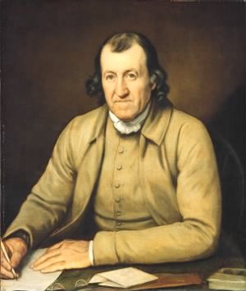
A MASTER “WRITER”
TIMOTHY MATLACK
OFFICIAL SCRIBE OF THE SCC
REWRITES D of I… TURNING IT INTO AN OFFICIAL DOCUMENT
  FORMAL
  NO MISSPELLINGS OR EDITS
  ELEGANT HANDWRITING

Slide 50
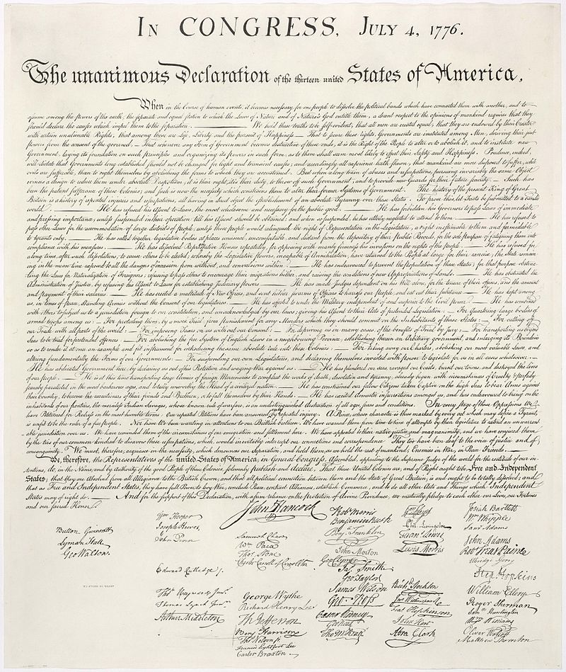
THE OFFICIAL COPY
AUGUST 2, 1776
THE PROCESS OF MATLACK’S COPY BEING SIGNED BY ALL 56 ORIGINAL SIGNERS BEGAN (JULY 4, 1776)
  WOULD TAKE ONE MONTH TO COMPLETE
**THIS COPY IS WHAT MOST PEOPLE HAVE COME TO KNOW**

Slide 51
THE PEOPLE

Slide 52
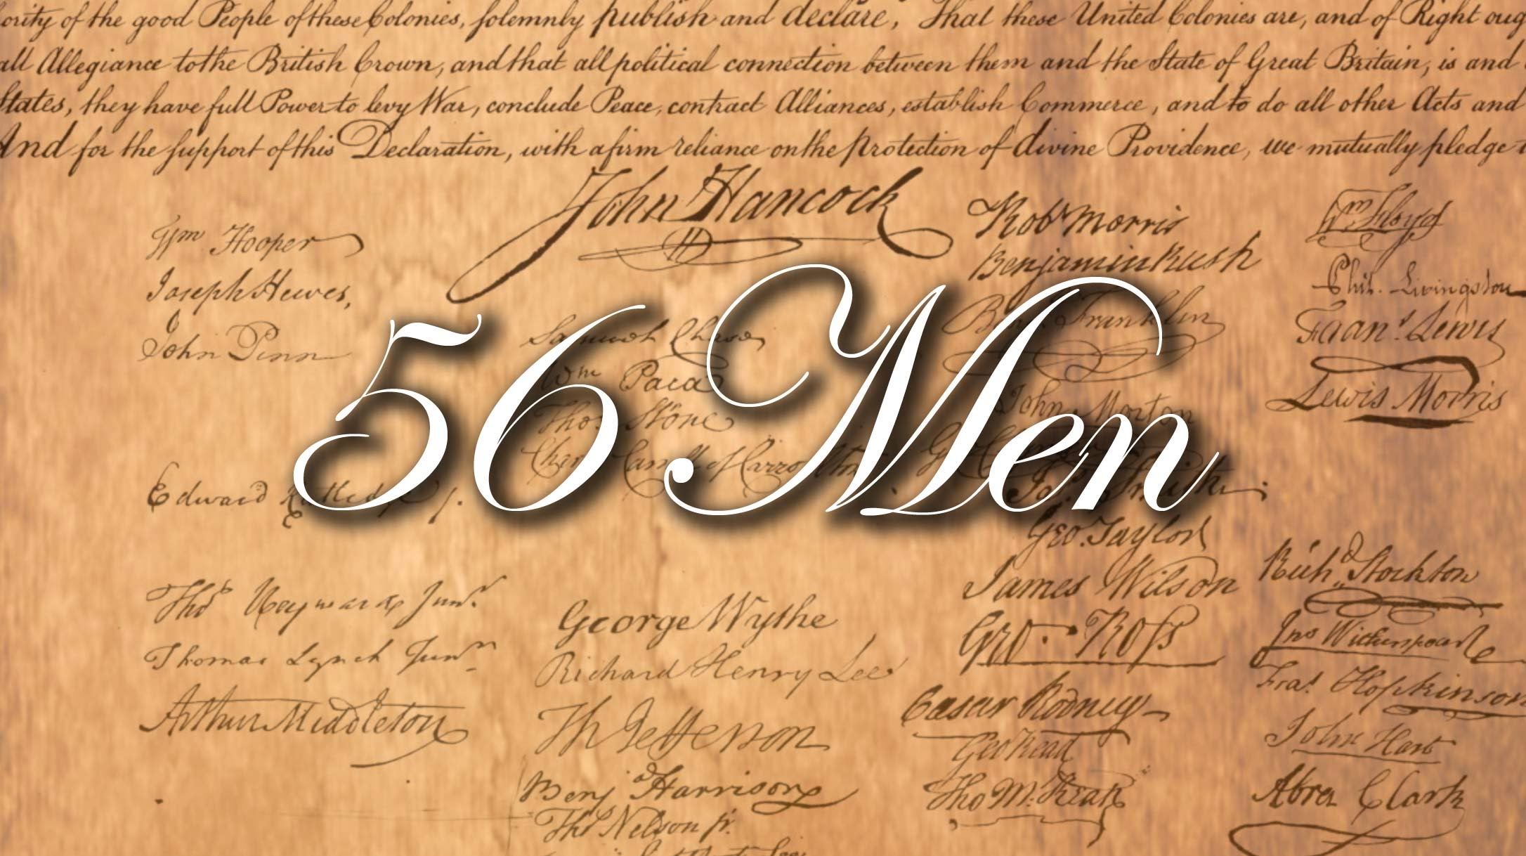
“COLLABORATION IS THE BEATING HEART OF COOPERATION”
COUNTLESS CONVERSATIONS AND COMMITTEES MADE THIS MOMENT A REALITY
LIKE DEMOCRATIC GOVERNMENT… DEMOCRATIC WRITING IS SLOWER BUT THE POSSIBILITY OF SUCCESS IS HIGHER!
  EX: HOLIDAY CELEBRATIONS
    HOW DOES EVERY DECISION GET MADE???

Slide 53
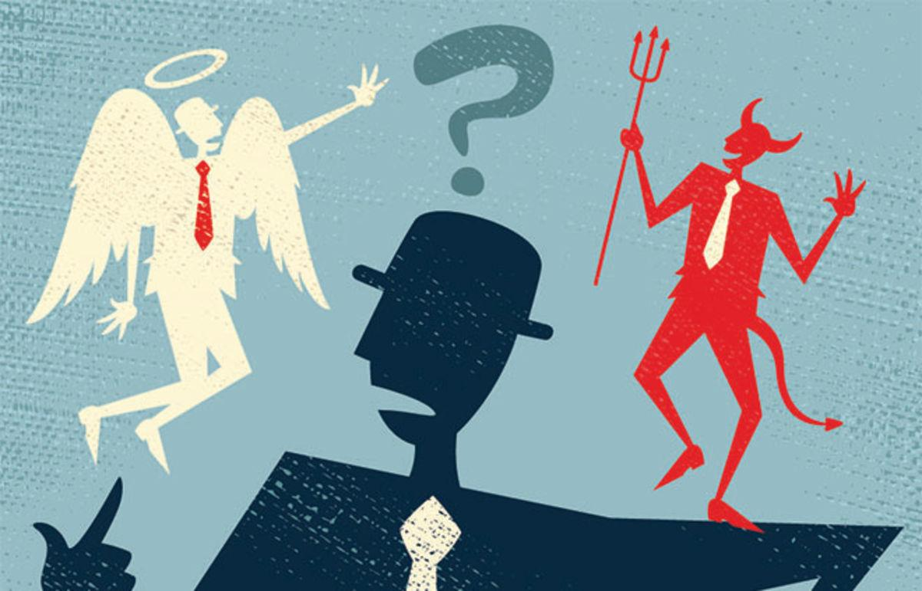
MORAL SENSE
** REFER TO FINAL SENTENCE IN PART 2**
“LET FACTS BE SUBMITTED TO A CANDID WORLD.”
  CANDID MEANS?
  THE WRITERS ASSUME EACH READER IS HONEST, RATIONAL, MORALLY SENSIBLE
    EACH READER IS A “JUDGE”
  WE ARE ALL EQUAL IN THE ABILITY TO JUDGE WHAT IS RIGHT

Slide 54
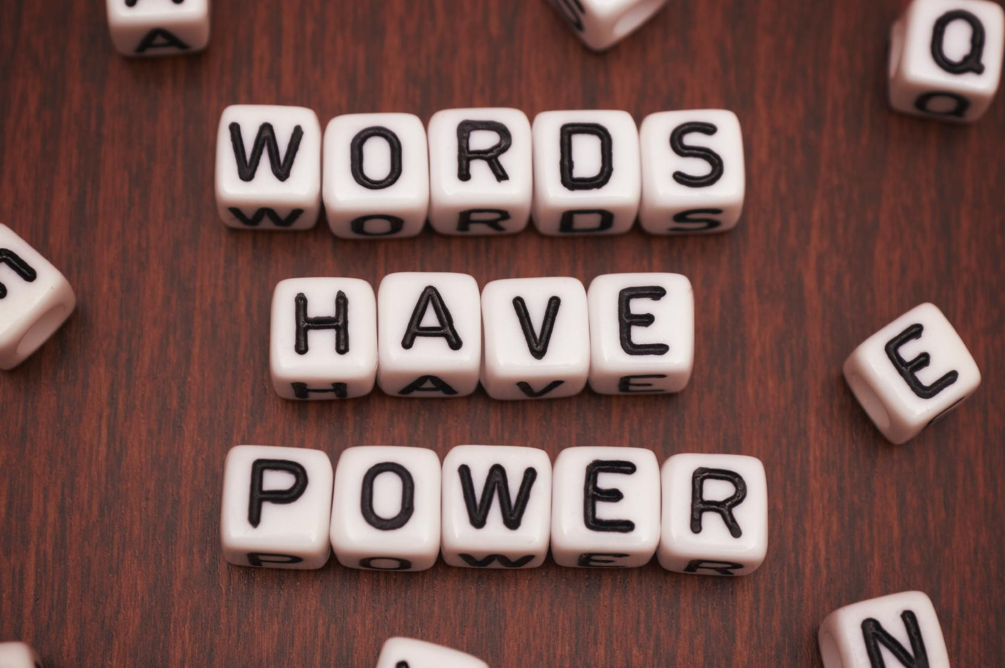
CHANGING OUR LIVES
WORDS HAVE THE POWER TO ALTER OUR WORLD
HOW COULD SAYING “I DO” CHANGE YOUR WORLD EMOTIONALLY? LEGALLY?
ODDLY… THE D of I READS LIKE A DIVORCE!
  LAST PARAGRAPH… “THAT THESE UNITED COLONIES ARE, AND OF RIGHT OUGHT TO BE FREE AND INDEPENDENT STATES…”
  TWO KEY WORDS?
IN THE END… THE COLONIES WANT TO GET REMARRIED TO EACH OTHER
  “... WE MUTUALLY PLEDGE TO EACH OTHER OUR LIVES, OUR FORTUNES, AND OUR SACRED HONOR.”
** CLASS WEDDING**

Slide 55

WHAT ABOUT PERMISSION?
IN A WEDDING, CONSENT MUST BE GIVEN
FATHER GIVES AWAY THE BRIDE
“SPEAK NOW OR FOREVER HOLD YOUR PEACE”
WHAT ABOUT DIVORCE?
KGIII: SENT SHIPS TO ATTACK COLONIES
COLONIES: WRITING A D of I
THE DECLARATION OF INDEPENDENCE IS A SEARCH FOR CONSENT FROM ALL WHO READ IT… THE SIGNERS WANTED THE PERMISSION OF ALL PEOPLE!!

Slide 56
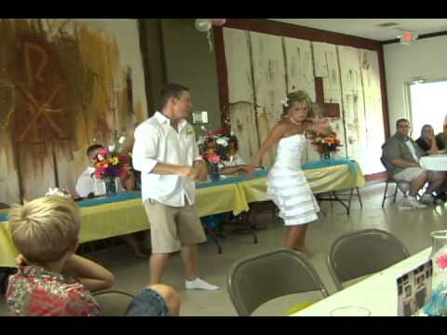
:52-2:01

Slide 57
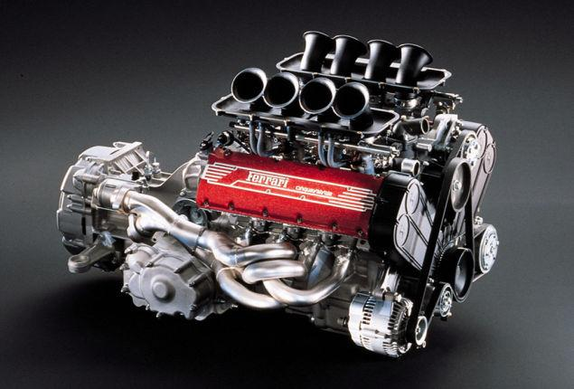
THE REAL REASON
THE DECLARATION OF INDEPENDENCE WAS MEANT TO CREATE THE WILL TO REVOLT
THE ENGINE IN A POWERFUL MACHINE WHICH COULD CHANGE THE WORLD

Slide 58
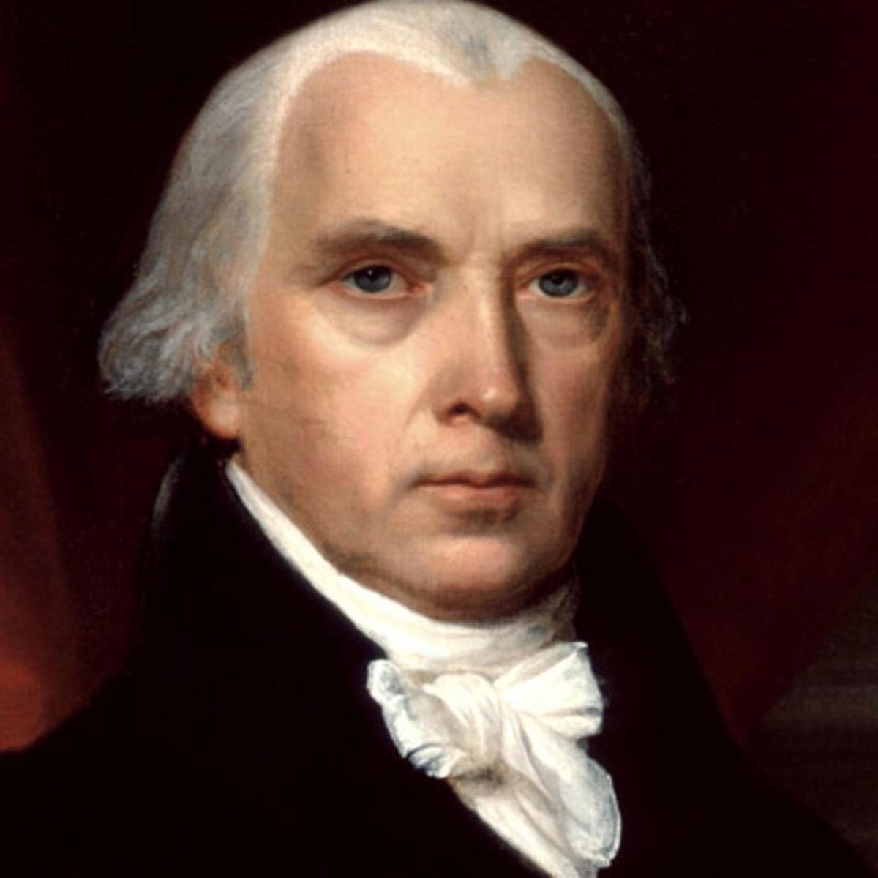
WORDS AND POWER
COMING TO A CONSENSUS IS MESSY AND HECTIC
http://classroom.monticello.org/kids/gallery/image/91/Jeffersons-Rough-Draft-of-the-Declaration-of-Independence/
WHOMEVER COULD MASTER THE WRITTEN WORD... HAD THE POWER!
EX: JAMES MADISON
  HELPED DRAFT THE CONSTITUTION
  THE FEDERALIST PAPERS
  WASHINGTON’S FIRST INAUGURAL ADDRESS
  CONGRESSIONAL RESPONSE
  WASHINGTON’S RESPONSE TO CONGRESS
“THE EARLY HISTORY OF OUR COUNTRY WAS MAINLY JAMES MADISON TALKING TO HIMSELF.”

Slide 59
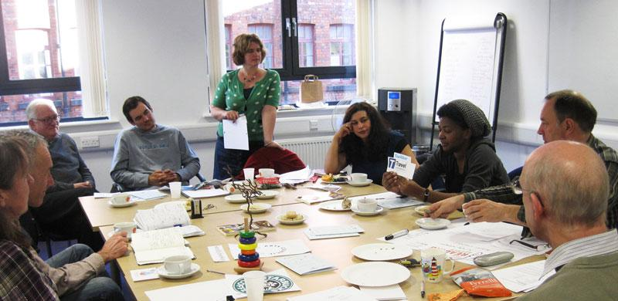
DEMOCRATIC WRITING
THE PRESSURE OF WRITING THE D of I WAS MONUMENTAL BECAUSE…
EVERY WORD HAD TO BE PURPOSEFULLY CHOSEN
THIS DOCUMENT REPRESENTED “WHO” AND “WHAT” AMERICA WAS AND IS
THIS DOCUMENT DETERMINED HOW THE REST OF THE WORLD WOULD JUDGE US

Slide 60
READING THE DECLARATION OF INDEPENDENCE

Slide 61
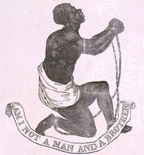
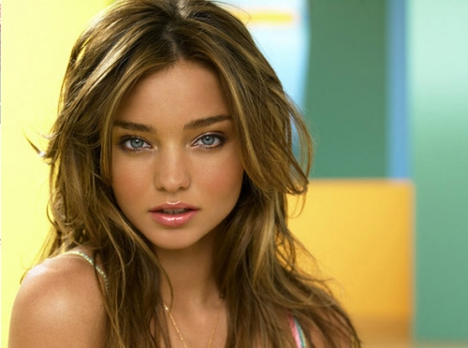
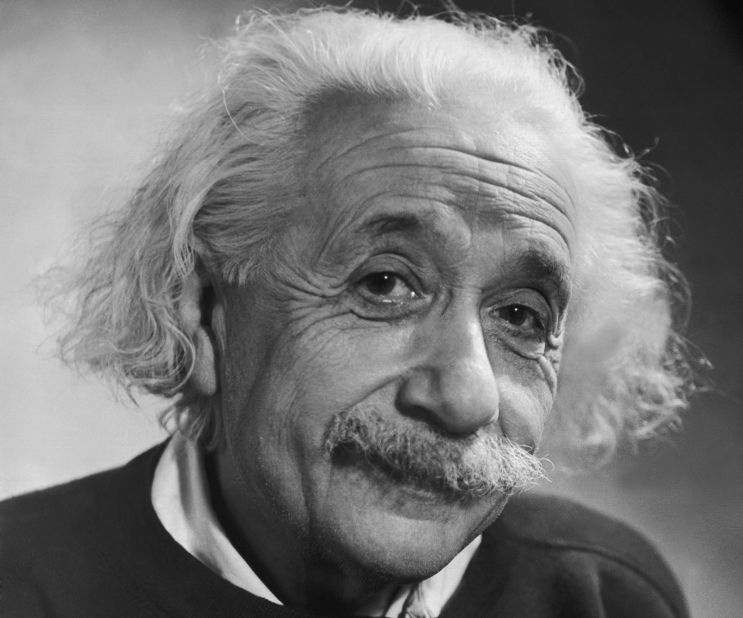

WHAT IS IT ALL ABOUT?
TWO CORE IDEAS: EQUALITY, FREEDOM
“ALL MEN ARE CREATED EQUAL”...????
EQUAL DOES NOT MEAN SAME
THE SIGNERS’ ARGUMENT
EQUAL IN THAT WE ARE ALL HUMAN BEINGS
EQUALITY IS THE FOUNDATION OF FREEDOM

Slide 62

THE INTRODUCTION IS EVERYTHING!!
Start: 1:00

Slide 63

JUST ANOTHER WORD FOR RIVER...
** READ “When in…” to “...with another.”
WHY BOTHER WITH “IN THE COURSE OF HUMAN EVENTS”??
LIKE A RIVER’S FLOW, HUMAN EVENTS CAN BE ALTERED
“WHEN IN THE COURSE…” TELLS THE READER THIS DECLARATION WAS NOT DONE ON A WHIM
  PAST EVENTS WERE TAKEN INTO ACCOUNT
  THIS KNOWLEDGE FORCED THE SIGNERS TO CUT A NEW PATH

Slide 64
JUST ANOTHER WORD FOR RIVER...
WHY IS THIS IMPORTANT?
It is our job as citizens to recognize when “the river” (a.k.a. human events) MUST BE ALTERED thus avoiding being controlled

Slide 65

ONE PEOPLE...
QUITE AN ODD CHOICE OF WORDS: “...IT BECOMES NECESSARY FOR ONE PEOPLE…”
HOW ARE WE “ONE PEOPLE”??
FROM VARIOUS PARTS OF EUROPE
SOME WANTED RELIGIOUS FREEDOM, JOBS, ESCAPE THE LAW, ETC.
OUR HISTORY IS “ENGLISH”
  LANGUAGE
  RELIGION
  FOOD
  DRESS
  EDUCATION

Slide 66

GETTING DRESSED FOR SCHOOL IS TOUGH!

Slide 67
ONE PEOPLE...
HOW COULD THE SIGNERS BELIEVE THE COLONISTS WERE “ONE PEOPLE”??
ACCORDING TO THINKERS OF THE PAST (JOHN LOCKE, THOMAS HOBBES, ETC.), POLITICAL RULE IS ONLY NEEDED BECAUSE INDIVIDUALS UNITE UNDER COMMON POLITICAL BELIEFS
THE AMERICAN STATES ARE ONE PEOPLE BECAUSE THEIR BELIEFS ARE UNITED
WE ARE NO LONGER LITTLE BROTHER!

Slide 68

WE ARE YOUR EQUALS… ????
**READ “To dissolve the political bands...of Nature’s God entitles them.”
England:
  3 x the population of the American Colonies
  #1 Navy in the world
  One of the wealthiest nations in the world
  Army was littered with experienced soldiers and schools of war
  The British govnt. and legal system dates back to 1066
Colonies:
  CC had no power to tax citizens to raise $$
  No national army existed yet (local militias)
  No national system of laws existed till 1783 (each colony had their own laws)

Slide 69

WE ARE YOUR EQUALS…???
**IN YOUR MIND, WHAT CAN MAKE YOU INDEPENDENT?**
HOW COULD THE SIGNERS HAVE POSSIBLY BELIEVED THE AMERICAN COLONIES WERE EQUAL TO ENGLAND?
not based on wealth, territory, etc.
The same as England... colonists have shown the ability to become a self-organizing, individual political unit (EX: colonial conventions, Continental Congresses)
No longer “colonies” BUT “states” (states do for themselves, colonies DO NOT)
WE ARE EQUAL IN THE POWER TO ORGANIZE POLITICALLY… WE ARE NOT THE SAME IN ALL THINGS ADMITTEDLY

Slide 70
QUICK REVIEW
BASED ON THE SELECTED WORDS OF SENTENCE #1...WHAT MESSAGES WERE THE WRITERS CONVEYING?
DECLARATION
OF
INDEPENDENCE

Slide 71

“LIKE” CAN BE UNLIKEABLE

Slide 72

THE POWER OF ONE WORD
** RE-READ THE SAME SENTENCE**
WHICH PHRASE IN THAT SENTENCE WILL SHAPE AMERICAN SOCIETY IN THE FIRST HALF OF THE 20TH CENTURY?
BY USING THE WORD “AND”, THE STATES CLEARLY STATED THEIR INTENTION TO BE COMPLETELY FREE
BY CHANGING ONE WORD… WE CHANGE HISTORY

Slide 73

SEPARATE “BUT” EQUAL
0-2:42

Slide 74

SEPARATE “BUT” EQUAL
“BUT” WAS A WORD USED TO:
CONTROL COLORED CITIZENS
KEEP THEM DEPENDENT ON A RULING CLASS
**ONE WORD CAN BE VERY POWERFUL**

Slide 75

AND WHAT OF “GOD”?
SENTENCE #1… “NATURE’S GOD” IS THE ONLY TIME “GOD” IS MENTIONED
  JEFFERSON BELIEVED “A” GOD PUT NATURE IN ORDER… NOT JUST A CHRISTIAN GOD
  “SACRED AND UNDENIABLE” HAD TOO MUCH OF A RELIGIOUS UNDERTONE… CHANGED
WHY?
  THE SIGNERS AND THEIR ARGUMENTS come from a place and person who is beyond the limits and imaginations of man… A Supreme Organizer who guides man and nature… NOT JUST CHRISTIANS

Slide 76

TRUST IN THE PEOPLE
READ “... a decent respect to the opinions of mankind requires that they should declare the causes which impel them to the separation.”
THE SIGNERS ARE CONFIDENT ENOUGH IN MANKIND’S ABILITY TO JUDGE FAIRLY AND MORALLY THAT THEY WILL STATE THE REASONS WHY THEY ARE BREAKING FREE OF ENGLISH CONTROL
WOULD KGIII HAVE EXPLAINED HIS DECISIONS TO HIS SUBJECTS?

Slide 77

TRUST IN THE PEOPLE
“Mr. Verch… that is crazy! There are a lot of dumb people in this world!!
JEFFERSON AND THE OTHER SIGNERS BELIEVED (AT A BASIC LEVEL) EVERYONE HAS A MORAL SENSE… TO BE RECOGNIZED AS A LEGITIMATE NATION… THE WORLD MUST ACCEPT THIS DECLARATION
0-1:03

Slide 78
REVIEW OF SENTENCE #1
The Signers looked at the scope of human history and its events
The decision was made to alter the path (current) which the American Colonies were on
The Colonists became a separate people from England because of different political beliefs
The Colonies were EQUAL to England because of the ability to become a self-organized political unit thus defend itself from outside domination
The Colonists are entitled to this equality by Nature’s God, a power beyond man himself (like gravity; equality JUST is)
The Signers placed a certain level of trust in readers to judge them fairly for their actions by feeling it proper to explain WHY they are declaring their independence
***PREP STUDENTS FOR “WRITE OWN DEC. OF INDEP. ACTIVITY***

Slide 79
SECTION 2
“WE HOLD THESE TRUTHS…”

Slide 80

LYING IS PART OF GROWING UP

Slide 81

FINDING THE TRUTH
99.9% OF THE TIME… THE TRUTH IS THE BEST CHOICE
IN SECTION 2… WE FIND THREE TRUTHS ABOUT:
HUMAN BEINGS
GOVERNMENT
REVOLUTION

Slide 82

TRUTH #1
** READ FIRST SENTENCE**
AT EVERY HUMAN’S CREATION, THE SAME RIGHTS ARE ACQUIRED
  TO SURVIVE
  TO BE FREE FROM DOMINATION
  TO BE HAPPY
“MR. VERCH… WHAT ABOUT ANIMALS?”
  DOES YOUR PET WANT THE SAME?? YES

Slide 83

THE ANIMAL KINGDOM

Slide 84


THE DIFFERENCE: MAN V. ANIMAL
** READ “THAT TO SECURE… OF THE GOVERNED.”
THERE ARE NO GOVERNMENTS AMONGST ANIMALS
  OWN HIERARCHIES, SURVIVAL METHODS
MAN SECURES THESE INALIENABLE RIGHTS BY WAY OF ???????

Slide 85

TRUTH #2
GOVERNMENT
THE TOOL WHICH MAN USES TO PRESERVE THE RIGHTS OF LIFE, LIBERTY, AND THE PURSUIT OF HAPPINESS

Slide 86

TRUTH #3
** READ “THAT WHENEVER ANY FORM...SAFETY AND HAPPINESS.”
IF A GOVERNMENT DOES NOT PRESERVE THE RIGHTS OF ITS PEOPLE… THE PEOPLE MUST ACT AND CREATE NEW GOVERNMENT
**REVOLUTION**

Slide 87

EVERYTHING HAS A BEGINNING

Slide 88

A “CREATOR”
*** READ “WE HOLD THESE… UNALIENABLE RIGHTS”
WHAT ROLE DOES A “CREATOR” PLAY IN OUR POSSESSING CERTAIN UNALIENABLE RIGHTS?

Slide 89

TO BE “ENDOWED”?
FROM LATIN WORD “DOTO”... GIVING A DOWRY TO A BRIDE TO BE MARRIED
  FROM MEDIEVAL TIMES… A FAMILY PROVIDES THE BRIDE WITH MONEY GOING INTO THE MARRIAGE
  INCREASES DESIRABILITY OF BRIDE WITH POTENTIAL SUITORS
  WIFE WILL ALWAYS HAVE A FINANCIAL SUPPORT… NO MATTER WHAT HAPPENS
  DOWRY CANNOT BE TAKEN FROM THE BRIDE

Slide 90

TO BE “ENDOWED”?
THESE UNALIENABLE RIGHTS ARE PROPERTY THAT WE GET FROM NATURE’S GOD (CREATOR)
THIS PROPERTY CAN NEVER BE TAKEN AWAY FROM US… THE RIGHT TO:
  LIVE
  BE FREE
  PURSUE HAPPINESS
**TRY TO TAKE THEM AWAY? ROB MAN OF HIS HUMAN PROPERTY

Slide 91

THE PROTECTOR
GOVERNMENT…
WILL PREVENT OUR RUIN AS A PEOPLE AND AS A COUNTRY

Slide 92

OUR GREATEST GIFT
THE DESIRE FOR PEACE…
IS THE DOWRY GIVEN TO US BY OUR CREATOR....
NATURE’S GOD

Slide 93

FUN TO BE A KID
0-3:12

Slide 94




BEAUTIFUL OPTIMISM
THE GREAT “BEAUTY” OF THE TEXT ARISES FROM HOW THE IDEAS ARE COMBINED WITH PROCESS…
ALL PEOPLE HAVE EQUAL RIGHTS AND EQUAL ACCESS TO PROTECT IT
IN SECTION 2, WE SEE A SUBLIME OPTIMISM ABOUT HUMAN POTENTIAL

Slide 95




Slide 96

2:46-3:25

Slide 97

HAVE A LITTLE FAITH
READ “THAT WHENEVER...SAFETY AND HAPPINESS”
FUNDAMENTAL OF EQUALITY: NO ONE CAN JUDGE YOUR HAPPINESS LIKE YOU!!
EVERY PERSON CAN PARTICIPATE IN POLITICS BECAUSE EACH OF US IS THE BEST JUDGE OF OUR HAPPINESS
  TRUST IS PLACED IN THE PEOPLE TO ALWAYS BE EVALUATING THEIR OWN LIVES
  THE SIGNERS TRUST THAT PEOPLE WILL RESPOND WHEN THEIR RIGHTS ARE STOLEN

Slide 98

THE POWER TO JUDGE
READ “BUT WHEN A… SYSTEMS OF GOVERNMENT”
BASED ON OUR PRESENT… WE JUDGE THE FUTURE
EVERY PERSON MAKES THESE DECISIONS EVERY DAY
WE ARE ALL EQUAL IN OUR ABILITY TO JUDGE… NOT EQUAL IN OUR ABILITY TO BE RIGHT
** THE SIGNERS HAD TOTAL OPTIMISM IN MAN’S ABILITY SEE THE PRESENT AND JUDGE FUTURE EVENTS
EX: REVOLT AGAINST A GOVERNMENT WHICH IS DENYING OUR UNALIENABLE RIGHTS

Slide 99

THE VALUE OF COMMUNICATION
THINK ABOUT HOW THE D of I WAS WRITTEN...
  COMMITTEES
  MEETINGS IN EACH COLONY
  1ST, 2ND CONTINENTAL CONGRESSES
OUR COUNTRY BEGAN WITH CONVERSATIONS… SHARING OUR FEELINGS OF HAPPINESS
EVERY PERSON DESERVES EQUAL ACCESS TO GOVERNMENT… WHICH PROTECTS HAPPINESS

Slide 100
SECTION 3
“HE HAS REFUSED…”

Slide 101

THE HEART OF THE DECLARATION
END OF SECTION 2:
“THE HISTORY OF THE PRESENT KING OF GREAT BRITAIN IS A HISTORY OF REPEATED INJURIES AND USURPATIONS, ALL HAVING IN DIRECT OBJECT THE ESTABLISHMENT OF AN ABSOLUTE TYRANNY OVER THESE STATES. TO PROVE THIS, LET FACTS BE SUBMITTED TO A CANDID WORLD.”
ALL READERS ARE ASKED TO BE JUDGES
THE FACTS MUST PROVE KING GEORGE IS A TYRANT

Slide 102

PROOF OF INTENT
WHAT DOES “INTENT” MEAN?
THE SIGNERS MUST DISPLAY FACTS THAT SHOW KGIII INTENDED TO SECURE DOMINATION OVER THE COLONIES… NOTHING WAS AN ACCIDENT

Slide 103

A REPEATED HISTORY
“THE HISTORY OF THE PRESENT KING OF GREAT BRITAIN IS A HISTORY OF REPEATED INJURIES AND USURPATIONS…”
ANOTHER DEFINITION?
SIGNERS WANT THE WORLD TO KNOW AMERICANS CAN SEE THE PRESENT AND PROPERLY JUDGE THE FUTURE
IMAGINE YOU ARE THE SIGNERS…AND YOU BELIEVE EVERYTHING WAS PLANNED… WHAT ARE YOUR OPTIONS FOR REACTION??

Slide 104

THE ONLY CHOICE… IS TO FIGHT!
0-:41

Slide 105
SECTION 4
“IN EVERY STAGE OF THESE OPPRESSIONS…”

Slide 106

HOW DO YOU DEFINE THE “SOUL”?
0-1:19

Slide 107

HOW DO YOU DEFINE THE “SOUL”?
0-1:15

Slide 108

HEART AND SOUL
IN SECTION 3, THE GRIEVANCES AGAINST KGIII ARE THE HEART OF THE D OF I
THE D OF I NEEDED THE GRIEVANCES FOR THE COLONISTS TO CLAIM THEIR FREEDOM
IN SECTION 4, THE DIRECTION FOR WHAT AMERICA BELIEVES IT CAN BE WAS WRITTEN
… THE SOUL

Slide 109

THE BIRTH OF A FREE PEOPLE
** READ SEC.4, SENTENCE 1 &2**
WHAT DOES “REDRESS” MEAN?
RE-READ SENTENCE 2… WHAT DEMAND IS MADE?
AS ONE PEOPLE, SEPARATE AND EQUAL, WE REQUIRE SPECIAL TREATMENT AND KGIII IS NOT PROVIDING IT

Slide 110

SPECIAL TREATMENT
AMERICANS NEED A LEADER WHO CAN PROVIDE:
FREEDOM
PROTECTION
MATERIAL PROSPERITY
JUSTICE
PEACE
THIS IS WHAT A “FREE PEOPLE” DESERVE!

Slide 111

ONE WORD AFFECTS THE FUTURE
“In every stage of these Oppressions We have Petitioned for Redress in the most humble terms: Our repeated Petitions have been answered only by repeated injury.”
WHICH WORD WOULD SET A TONE OF UNITY THEN AND NOW?
THIS IS OUR FIRST ACTION AS A FREE PEOPLE!!

Slide 112

INABILITY TO LEAD
KGIII CHOSE TO IGNORE THE COLONISTS… TO TRY TO DOMINATE THEM
IF KGIII IS NOT PROVIDING FREEDOM, WHAT IS HE? (IN THE EYES OF THE SIGNERS)
SENTENCES 1 & 2 DEFINE WHAT KIND OF TREATMENT THE COLONISTS EXPECT
EQUALITY = FREEDOM

Slide 113

SIBLING “LOVE”

Slide 114

OUR BROTHERS...OUR ENEMIES
SECTION 4 PART 2:
“Nor have We been wanting in attentions to our British brethren. We have warned them from time to time of attempts by their legislature to extend an unwarrantable jurisdiction over us. We have reminded them of the circumstances of our emigration and settlement here. We have appealed to their native justice and magnanimity, and we have conjured them by the ties of our common kindred to disavow these usurpations, which, would inevitably interrupt our connections and correspondence. They too have been deaf to the voice of justice and consanguinity. We must, therefore, acquiesce in the necessity, which denounces our Separation, and hold them, as we hold the rest of mankind, Enemies in War, in Peace Friends.”

Slide 115

WE ARE (STILL?) A FAMILY
CONSANGUINITY
FROM LATIN
MEANS “A BLOOD RELATIONSHIP, SHARING A LINEAGE OR ANCESTRY WITH.”
WHY DO THE SIGNERS CARE TO EVEN MENTION THEIR “BLOOD RELATIONSHIP” WITH THE BRITISH PEOPLE???

Slide 116

WE ARE (STILL?) A FAMILY
** MOST EDITED SECTION IN ENTIRE D of I**
THE COLONISTS ISSUES ARE WITH KGIII… NOT THE BRITISH PEOPLE
THE COLONISTS HAVE LOOKED TO THEIR BRETHREN TO SUPPORT THEIR VIEWS AS FAMILY WOULD
ATTEMPTED TO DIVIDE THE BRITISH PEOPLE AND KGIII
  DO YOU SUPPORT US, BROTHER?
  DO YOU SUPPORT US, SISTER?

Slide 117

LOVE...BETRAYED
FROM SIGNERS’ VIEWPOINT:
WE WERE FORCED TO SEPARATE FROM KGIII (WE DID NOT WANT TO)
OUR BRETHREN DID NOT FOLLOW US IN THE DESIRE FOR INDEPENDENCE (BETRAYAL !!)
WE DID NOT WANT TO FIGHT AND MAKE ENEMIES… BUT WE HAVE NO CHOICE
“Enemies in War, in Peace Friends.”

Slide 118

OUR FINAL ACTION
SECTION 4 PART 3:
“We, therefore, the representatives of the united States of America, in General Congress, Assembled, appealing to the Supreme Judge of the world for the rectitude of our intentions, do, in the Name, and by Authority of the good People of these Colonies, solemnly publish and declare…”
THE COLONISTS ARE DIVORCING FROM KGIII AND ENGLAND… JUST LIKE A REAL DIVORCE… WHOSE PERMISSION DID THEY NEED?
HOW DO THE COLONISTS KNOW IF THEY WERE GRANTED THIS DIVORCE?

Slide 119

I HAVE HEARD THIS BEFORE!
“...That these United Colonies are, and of Right ought to be Free and Independent States; that they are Absolved from all Allegiance to the British Crown, and that all political connection between them and the State of Great Britain, is and ought to be totally dissolved…”
JEFFERSON DID NOT WANT TO USE THESE WORDS… THE SCC HAD HIM ADD THIS
JEFFERSON ACCEPTED THAT HIS JOB WAS TO PUT INTO WORDS HOW THE SIGNERS FELT… THESE WORDS WERE PERFECT
DEMOCRATIC ART!!

Slide 120

THE END OF THE BEGINNING
“... and that as Free and Independent , they have full power to levy War, conclude Peace, contract Alliances, establish Commerce, and to do all other Acts and Things which Independent States may of right do. And for the support of this Declaration, with a firm reliance on the protection of divine Providence, we mutually pledge to each other our Lives, our Fortunes and our sacred Honor.”
WHATEVER OCCURS FROM THIS POINT…
WE EXPERIENCE AS ONE NATION!!!

Slide 121

THE STAR SPANGLED BANNER (SUPER BOWL XXV)
:38-3:15

